Slide 1

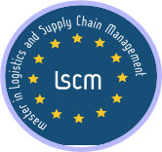



New Warehouse Establishment
Madir Kali
Jamia Begum
Anantha Krishna Bhatt
Akshatha Hombegowda
Abdul Halim Bin Abdul Hamid
http://www.free-powerpoint-templates-design.com

Slide 2
Contents
Our Company
Agenda
Work Breakdown Structure
Supply chain & Sales – China
Supply chain & Sales – Africa
Legal and Compliance
Cost & Profit Analysis

Slide 3
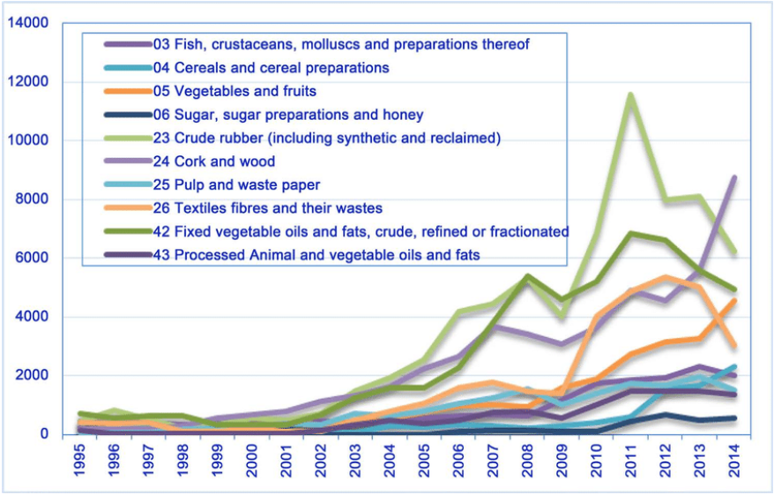
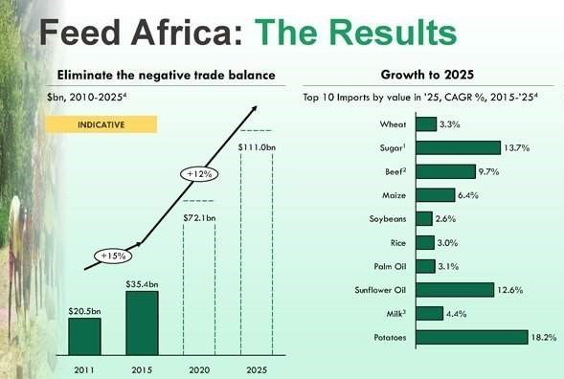
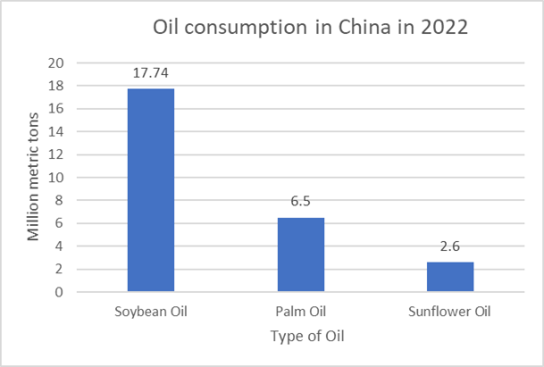
WHY…?
Food Commodities export of China
Notes:
Courtesy:
https://www.downtoearth.org.in/news/a-grain-revolution-for-africa-58672
https://www.afdb.org/en/the-high-5/feed-africa

Slide 4
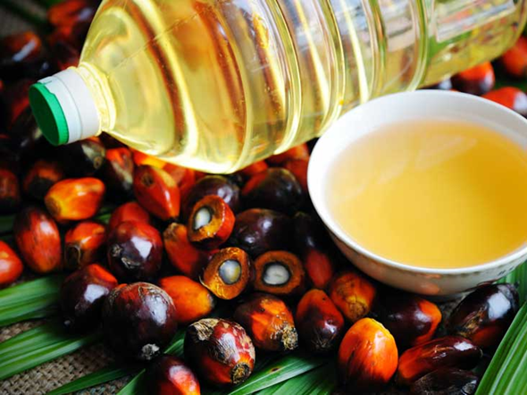


OUR COMPANY
A well-known International food distribution company, based in China
Pre-dominant distributors of edible oil like Palm Oil, Soybean Oil & Sunflower
Advantages of these oils :
Long Shelf Life
Can be easily procured from manufacturers in China
Ease of exporting / distributing
Distributes in the form of packed goods in local markets and exports in bulk quantities world-wide.
Company Revenue previous year: 4500M €
Notes:
Shelf Life of min. 1 year

Slide 5
AGENDA
Due to increase in Sales, Company is planning to establish a new warehouse
2022
2023
2024
2018
2019
SALES: 4500M €
25% Increase in Sale
New warehouse should be established in China to serve Markets in China and Africa
By February 2024, Golden Seed should expand its distribution by opening another warehouse in China to increase sales.

Slide 6
CHINA – AFRICA TRADE RELATIONSHIP
China is still predicted to have the fastest-developing economy per capita.
Huge production volumes, it is very difficult for local businesses to compete with such a strong player.
China has a positive impact on investment in infrastructure and business development
Import
China currently has military alliances with 6 African states, 4 of which are major oil suppliers: Sudan, Algeria, Nigeria and Egypt.
01
CHINA
AFRICA
Export
OBOR Initiative
December 2015, the China-Africa Cooperation, "Advancing towards mutual benefit and common development“ got established to increase investment in African continent
In 2016, the investment from China reached eighteen times more i.e, $ 36.1
02
Trade between China and Africa increased by 700% during the 1990s, and China is currently Africa's largest trading partner.
Notes:
There have increasingly been closer political, security and economic ties between China and African nations.

Slide 7
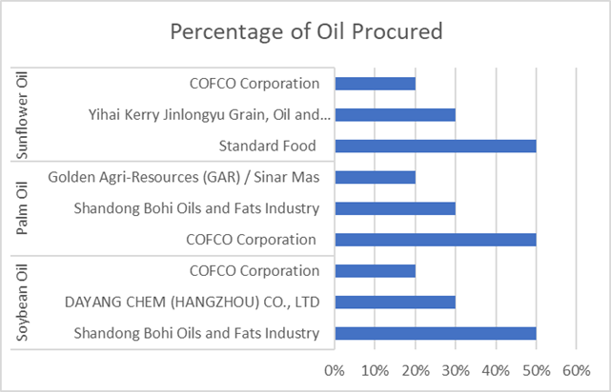
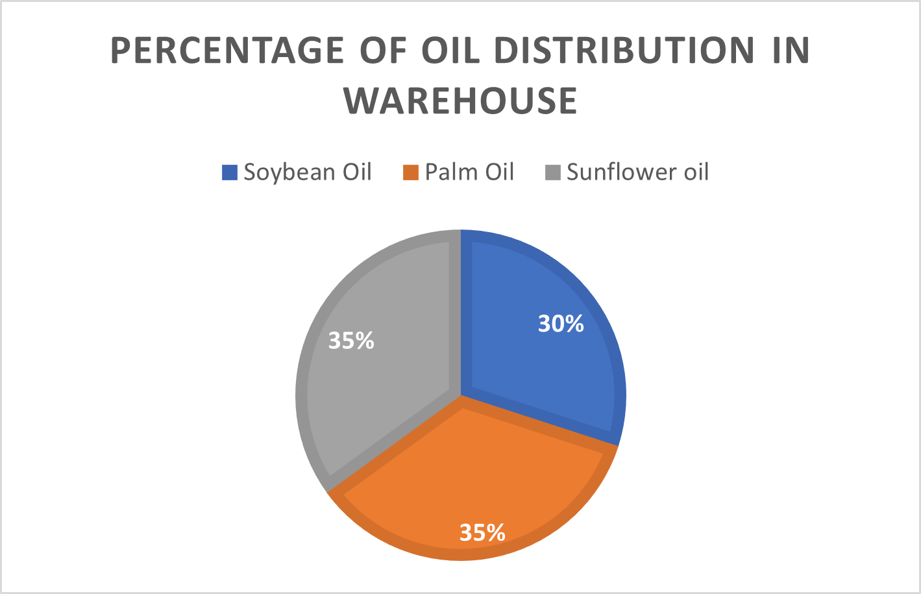
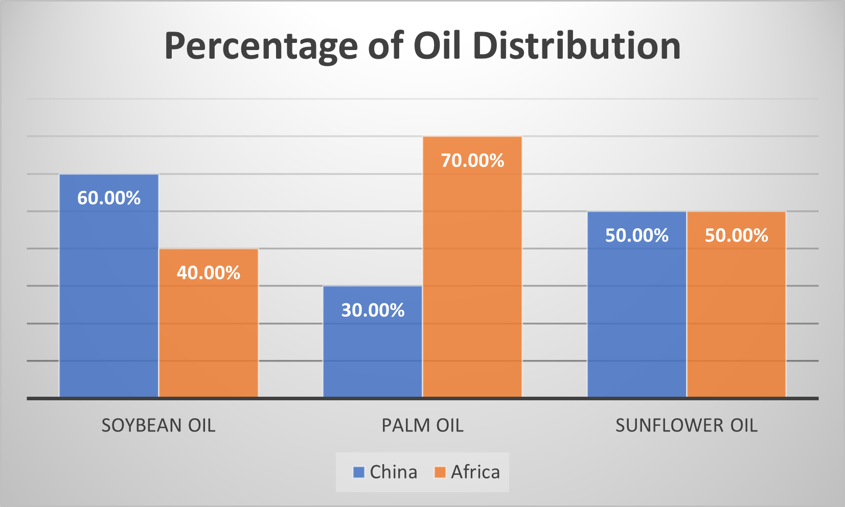
Oil procurement from Vendors
Oil Distribution in Warehouse
OIL DISTRIBUTION
Oil Distribution in Market

Slide 8
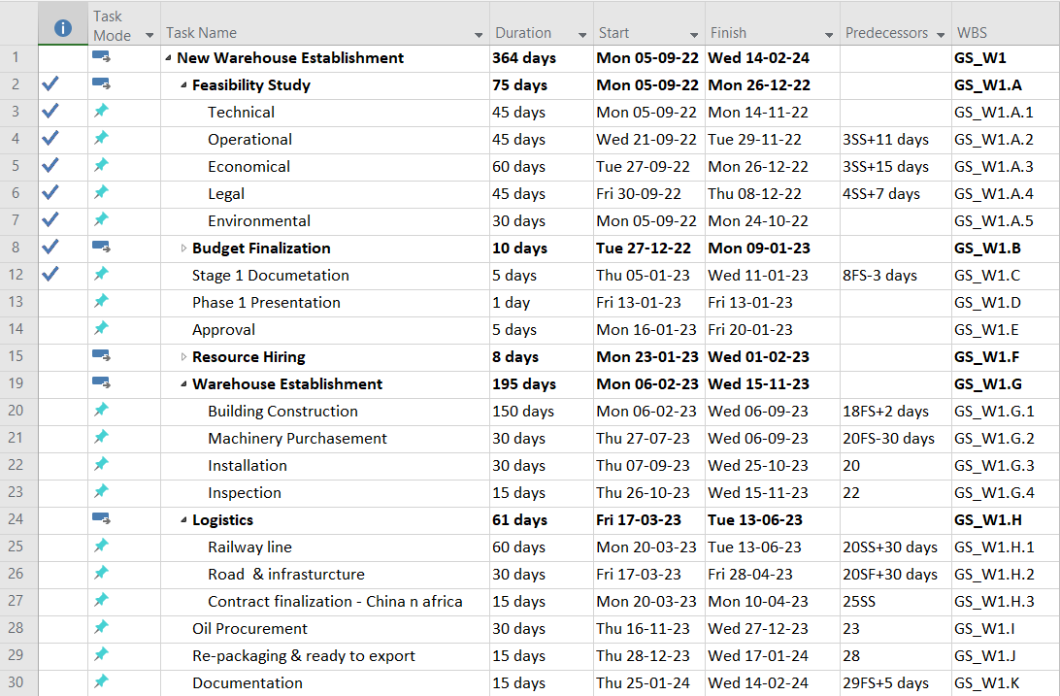
WORK BREAKDOWN STRUCTURE

Slide 9
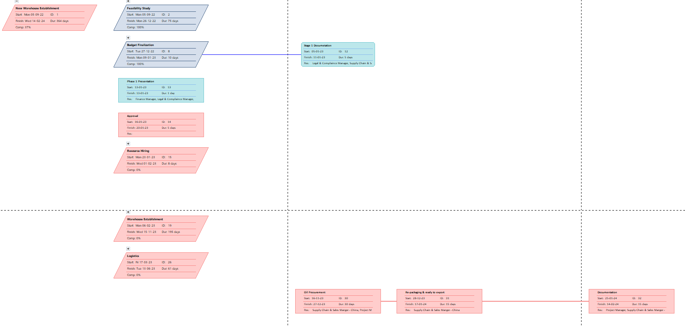
NETWORK DIAGRAM

Slide 10
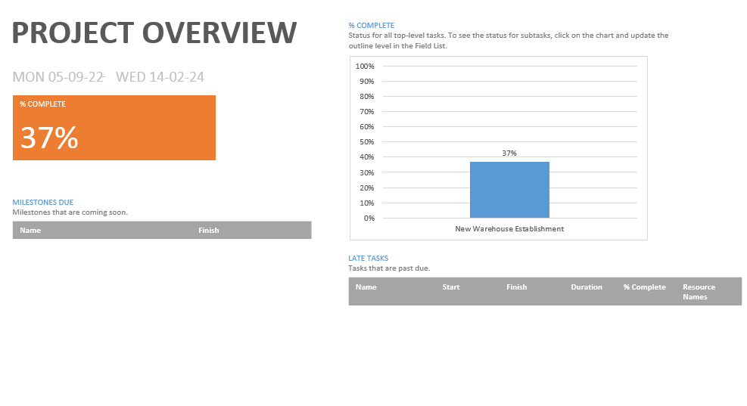
RESOURCES
PROJECT OVERVIEW
Supply Chain & Sales Manager - Africa
Supply Chain &
Sales Manager- China
Project Manager
Legal & Compliance Manager
Finance Manager

Slide 11
SUPPLY CHAIN & SALES in CHINA
http://www.free-powerpoint-templates-design.com

Slide 12
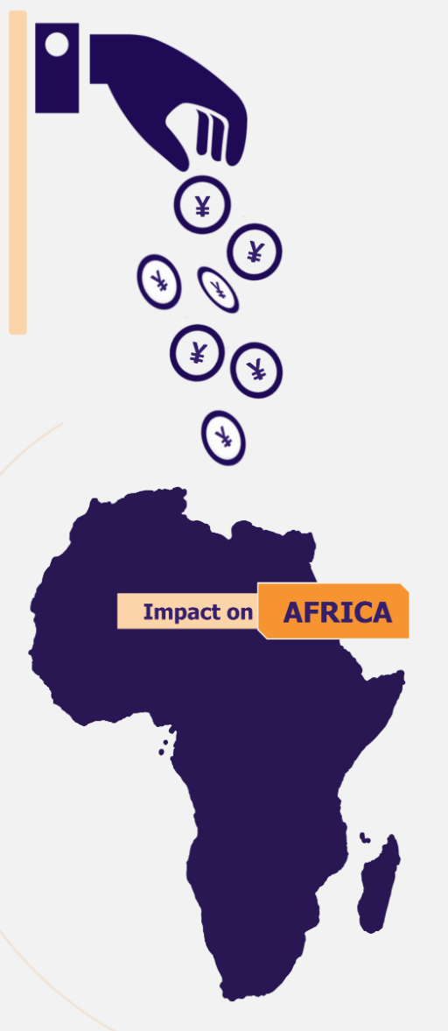
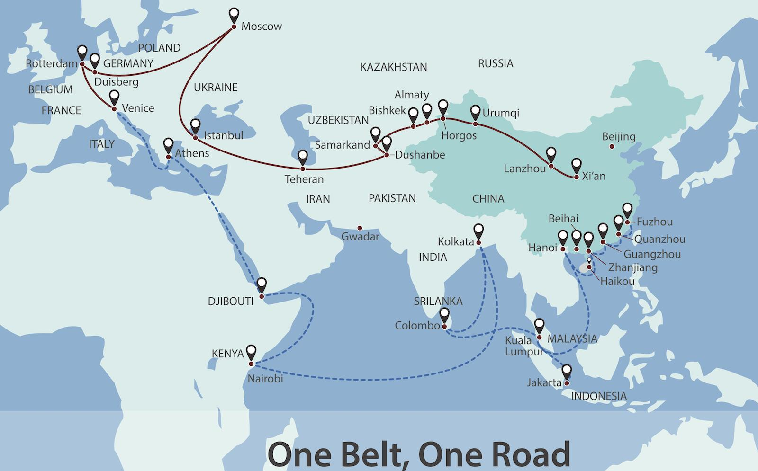
OBOR INITIATIVE
Cape Town, South Africa .
The initiative is a Chinese economic and strategic agenda by which the two ends of Eurasia and Africa and Oceania are being more closely tied along two routes–one overland and one maritime.
D
To access & transfer cheaper labor
To penetrate industries and nature resources
To dominate business opportunities
To boost export , generate revenue
To accelerate economic growth

Slide 13
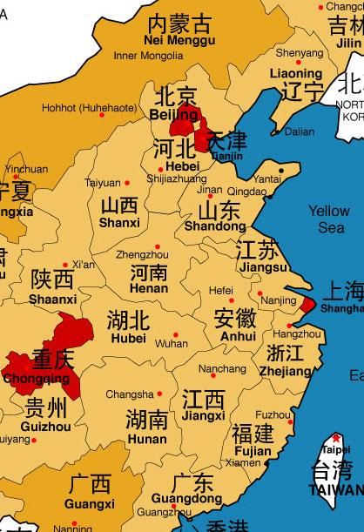
DISTRIBUTION IN CHINA
Beijing
Wuhan
Zhengzhou
Shijiazhuang

Slide 14
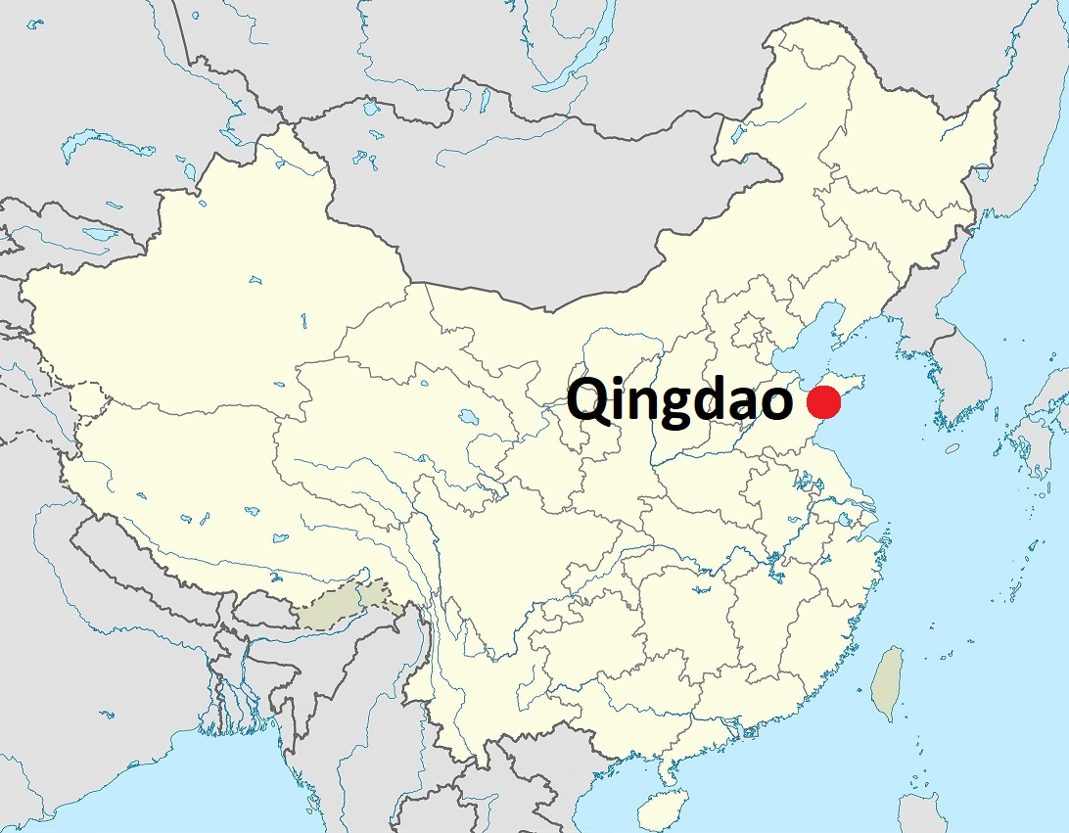
WAREHOUSE LOCATION IN CHINA
Location: Qingdao economic and technological development zone & Free Trade
Qingdao’s Blue Economy
Set up by the State Council in 1992 and has an area of 2.5 sq km.
Transportation hubs: raw materials in Central - Asia and Russia
Support of BR policy of China.
388.41 billion yuan ($60.98 billion) in 2021 which is 27% of its GDP
High-end, intelligent and green development,
promoting 7 industries: smart home appliances, rail transit, new energy vehicles, high-end chemicals, marine equipment, food and beverage, and textiles and garments.
Rich Scientific and Technological Talent Reserve

Slide 15
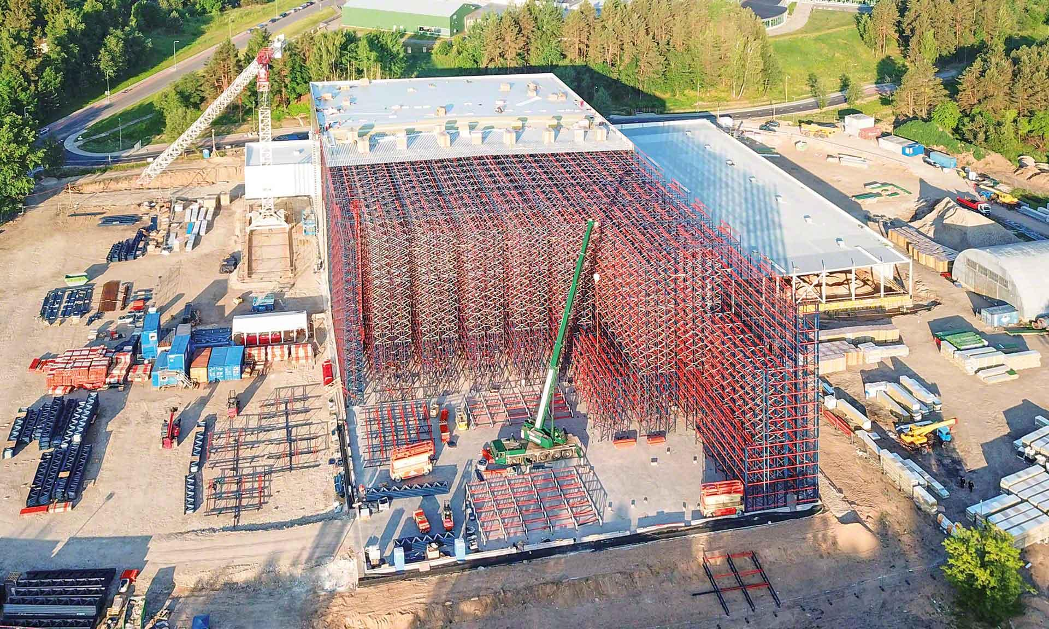
WAREHOUSE DEVELOPMENT PLAN
Floor space: 1000 sqm, 50 m H, silo-type, 3-aisle
Total capacity: 50000 m*3
Storage Capacity: 35000m3
Considering Non-Storage capacity = 30% = 15000m3
16025 pallets for Bottles storage
18 Oil tanks with 500m3 Capacity each = 500000 Liters
4 auto ramps
Climate control:
Storage temperature not higher 20°C
Maximum humidity 80%
Stability: the high-bay warehouse 4 meters into the ground silo structure
Built on a high-load-bearing foundation slab.
2 stacker crane with double play
5 forklift
Warehouse Management System
High Automation Rates
1 Locomotive
Notes:
The pallets that are staged in the various manufacturing lines and areas are received by forklift trucks and scanned manually. Load units for the high-bay warehouse are transported directly to the loading station. After the load units are placed on the conveying technology, they are transported automatically to the transfer point for the appropriate stacker crane. On the way there, the label of the pallet is scanned automatically. A profile control also checks the weight and dimensions and the space for the forks. Load units with excess dimensions or weights are discharged to a NIO processing station (NIO = Not In Order). There they can be corrected manually and then fed back into the system. As soon as the stacker crane has stored the load unit, the Kardex Control Center reports the completed order with its storage location number to the ERP system.

Slide 16
MODE OF TRANSPORTATION
Warehouse is using multimodal ways of transportation including:
Sea Port
Sea shipment for distribution to Africa
Road
Rail
Road for distribution in Qingdao Region
Railway for distribution across China

Slide 17
QINGDAO PORT
The transportation of edible oil from China to Africa
the physical limitation of the territory;
deep water of berths; port throughout;
Infrastructure ;
Financial component;
Political stability and other components.
Economically Profitability of Sea Shipment
Safety: containers ensure the complete safety of the cargo.
The 21st century maritime Silk Road that runs from the Chinese coast to Singapore, southern tip of India to Mombasa
Through the Red Sea and the Suez Canal to the Mediterranean Sea
Enters the Upper Adriatic to the northern Italian crossroads of Trieste connections to Central Europe and the North Sea..
Part of China's land transportation system
Connected to the hinterland by rail and two expressways
Provides specialized container storage services
for non-standard cargo
refrigerated goods
dangerous good

Slide 18
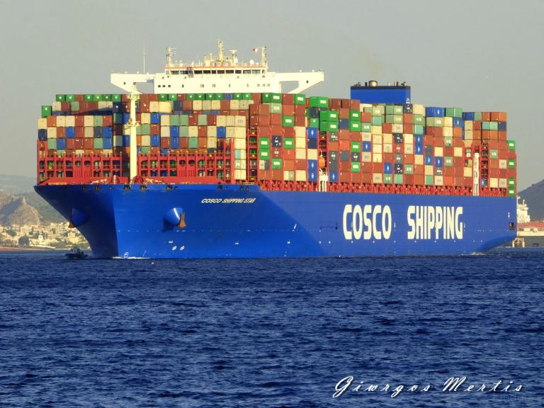
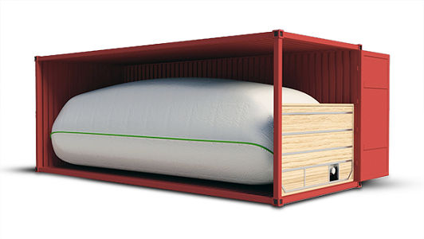
TRANSPORTATION PLAN
Type of Ships & Shipping time & cycles
Transporting will be made by “COSCO” Shipping
The shipment is made to: Mombasa (20-28 days), Suez (35 days), Capetown (25 days), Akkra (40-60 days).
Shipment made one time per month period and will be altered according to demand & procurement
Shipping unit: Flexi tanks
Flexi tank is an elastic loose tank made of special polymeric materials, with a volume of 14 to 24 thousand liters, which is used for the transportation and storage of liquid food, bulk, as well as industrial bulk liquid cargoes that do not pose a danger.

Slide 19
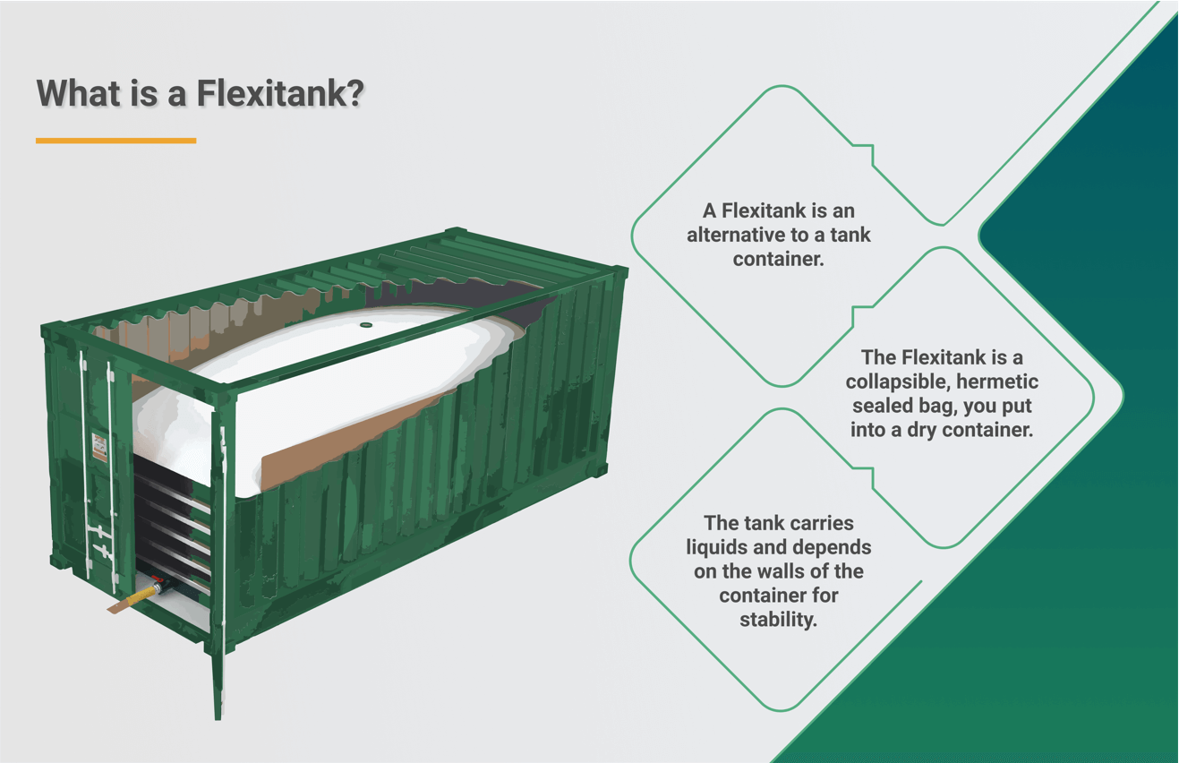
STORAGE UNIT FOR SHIPMENT
01
Flexi tank specifications
02
Flexi tank storage
Flexitank is an elastic loose tank made of special polymeric materials, with a volume of 14 to 24 thousand liters, which is used for the transportation and storage of liquid food, bulk, as well as industrial bulk liquid cargoes that do not pose a danger.
The flexitank is installed in a standard 20-foot container. It is important to choose the right container. It must be clean and undamaged. The inner surface is carefully checked for possible roughness and irregularities that could damage the liner.
Let's consider the advantages of cargo transportation by flexitank:
the transportation time is significantly reduced, since the mandatory procedure for cleaning tanks is excluded, and the installation time of the flexitank takes no more than 30 minutes;
Flexitanks are completely recycled and disposed of after transportation. There is no need to return the container, therefore, there are no corresponding costs
Relatively low shipping and installation costs;
Temperature control

Slide 20
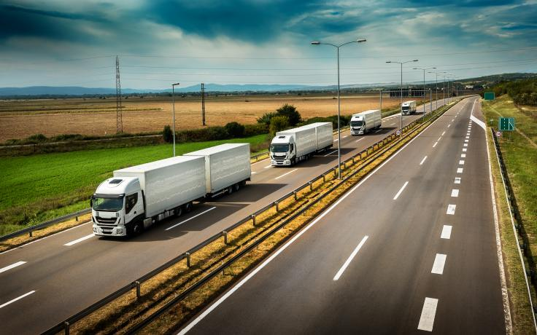
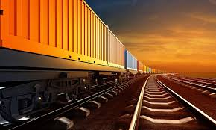
ROAD & RAILWAY DISTRIBUTION
Bottled products can be transported by al means of transport
Rail Transportation made to 4 cities: Zhengzhou, Beijing,Wuhan, Shijiazhuang
For transportation, company is outsourcing truck service in order to distribute production in Shandong region
Must use isometric vans
For the transportation of oil, it is required to use a specialized cargo transport with a closed surface.

Slide 21
SUPPLY CHAIN & SALES in AFRICA
http://www.free-powerpoint-templates-design.com

Slide 22

DEMAND & CONSUMPTION INDEX

Slide 23
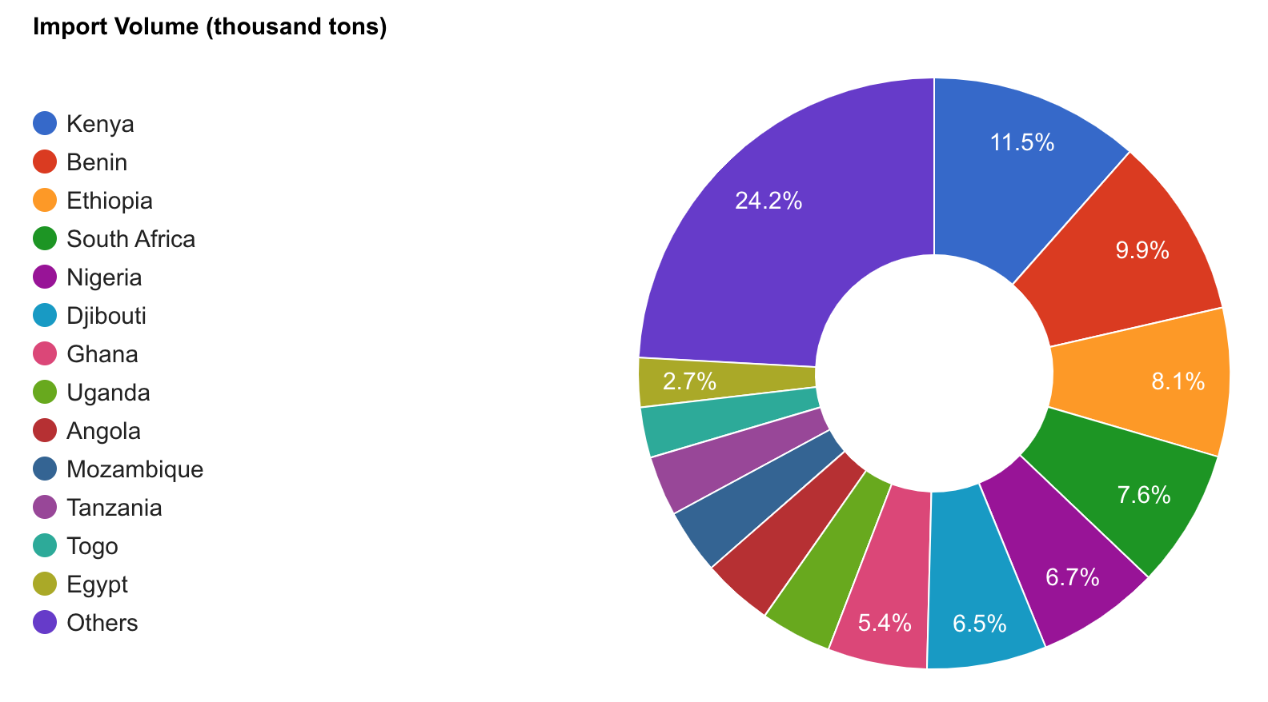
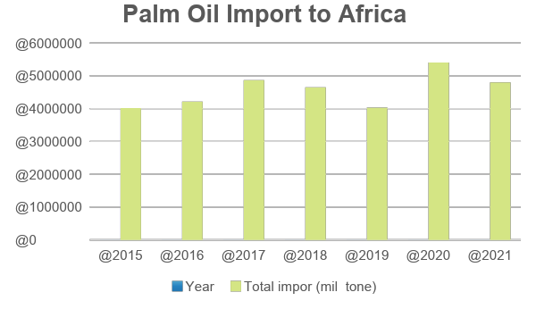
PALM OIL DEMAND & CONSUMPTION INDEX IN AFRICA
Palm oil import to Africa
Year | Total import (million tons)
2015 | 4015216
2016 | 4213672
2017 | 4867032
2018 | 4653878
2019 | 4030638
2020 | 5406728
2021 | 4800000

Slide 24
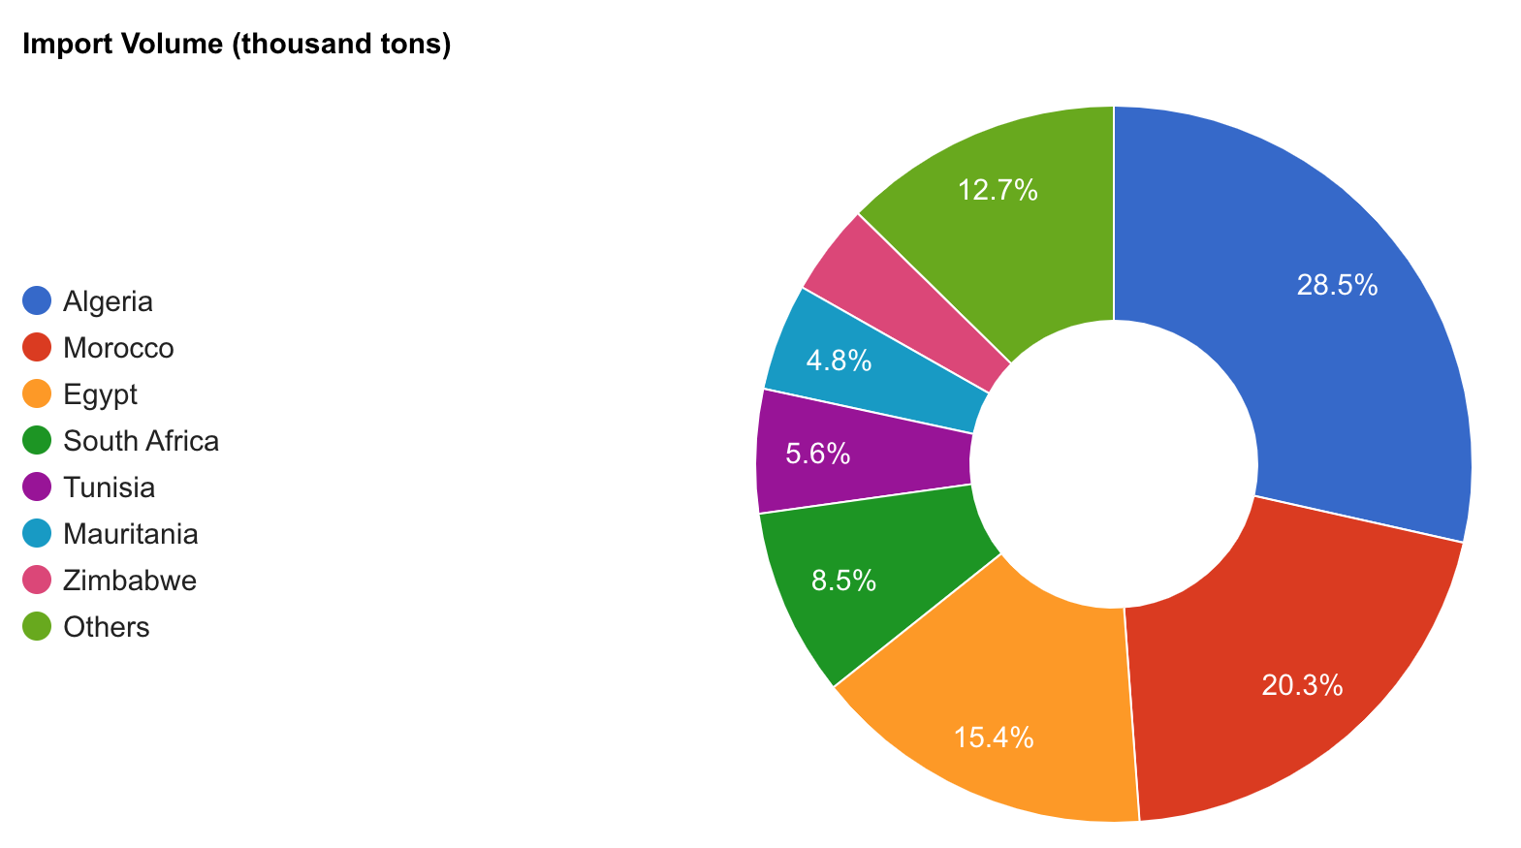
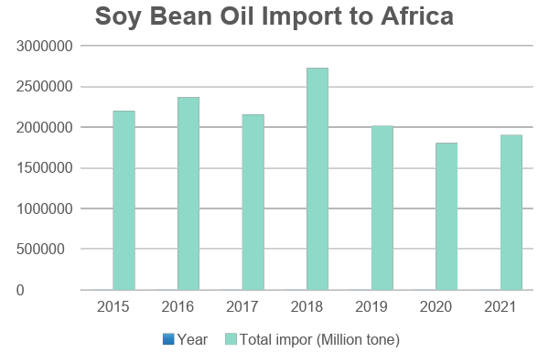
SOYBEAN OIL DEMAND & CONSUMPTION INDEX IN AFRICA
Soybeans Oil Import to Africa
Year | Total Import (Million tons)
2015 | 2200000
2016 | 2367907
2017 | 2155781
2018 | 2725790
2019 | 2015319
2020 | 1803364
2021 | 1903650

Slide 25
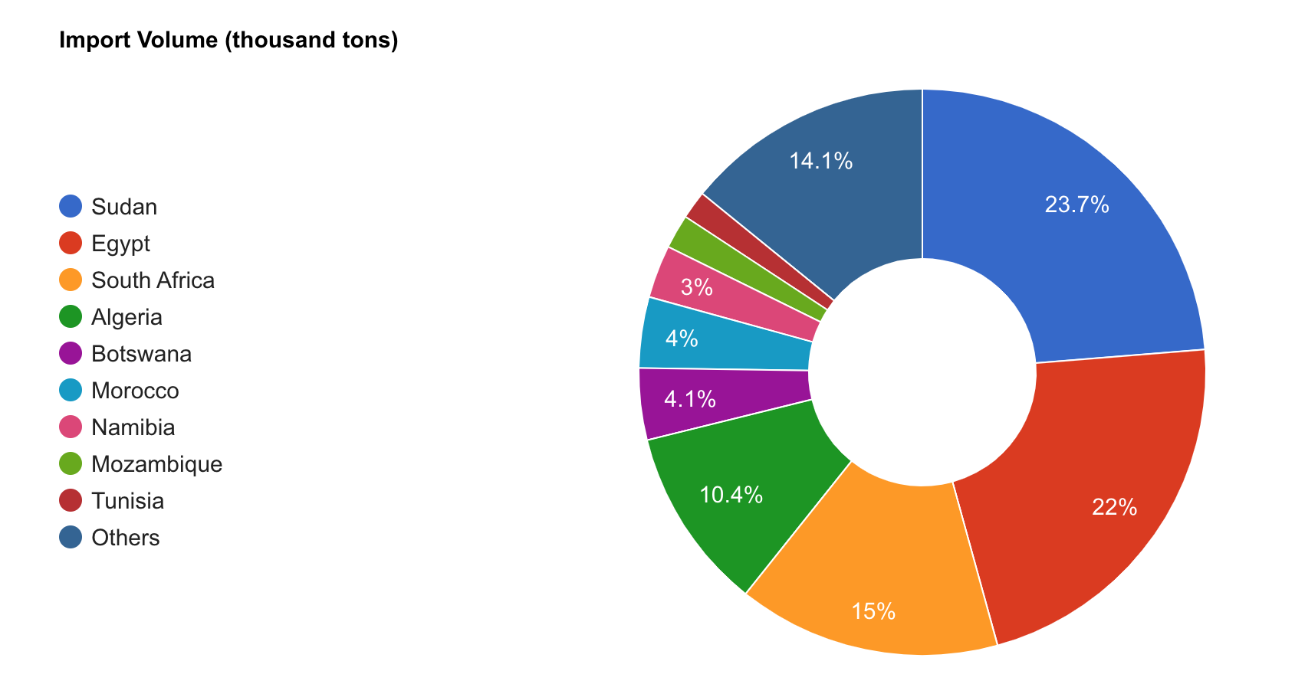
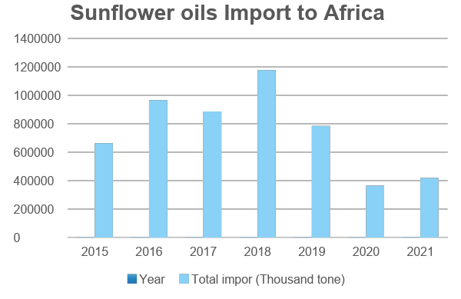
SUNFLOWER OIL DEMAND & CONSUMPTION INDEX IN AFRICA
Sunflower Oil import to Africa
Year | Total import (Thousand tons)
2015 | 663000
2016 | 965786
2017 | 886750
2018 | 1176590
2019 | 785020
2020 | 365713
2021 | 419670

Slide 26

OIL DISTRIBUTION PLAN: AFRICA
 | Demand distribute to Africa by region | Volume |  | Distribution to region (by %)
 |  | Per year | 1 month | SA | WA | CA | EA | NA
Soybean oil | Shandong Bohi Oils and Fats Industry | 1350000 | 337500 | 15% | 15% | 10% | 10% | 50%
 | DAYANG CHEM (HANGZHOU) CO., LTD | 810000 | 202500 | 15% | 15% | 10% | 10% | 50%
 | COFCO Corporation | 540000 | 135000 | 15% | 15% | 10% | 10% | 50%
Palm Oil | COFCO Corporation | 1575000 | 393750 | 15% | 30% | 30% | 10% | 15%
 | Shandong Bohi Oils and Fats Industry | 945000 | 236250 | 15% | 30% | 30% | 10% | 15%
 | Golden Agri-Resources (GAR) / Sinar Mas | 630000 | 157500 | 15% | 30% | 30% | 10% | 15%
Sunflower Oil | Standard Food | 1575000 | 393750 | 40% | 10% | 10% | 20% | 20%
 | Yihai Kerry Jinlongyu Grain, Oil and Food Co. | 945000 | 236250 | 40% | 10% | 10% | 20% | 20%
 | COFCO Corporation | 630000 | 157500 | 40% | 10% | 10% | 20% | 20%
Assumption:
Although the market demand is double the supply. China is not mainly an exporter country for palm oil and depends on availability from other suppliers or exporters such as Malaysia & Indonesia to supply to China.
High competition with Nigeria, the largest producer of palm oil in Sub-Saharan Africa with over 1.2 million MT of production in 2020, which is almost half of the entire palm oil production from Sub-Saharan Africa.

Slide 27
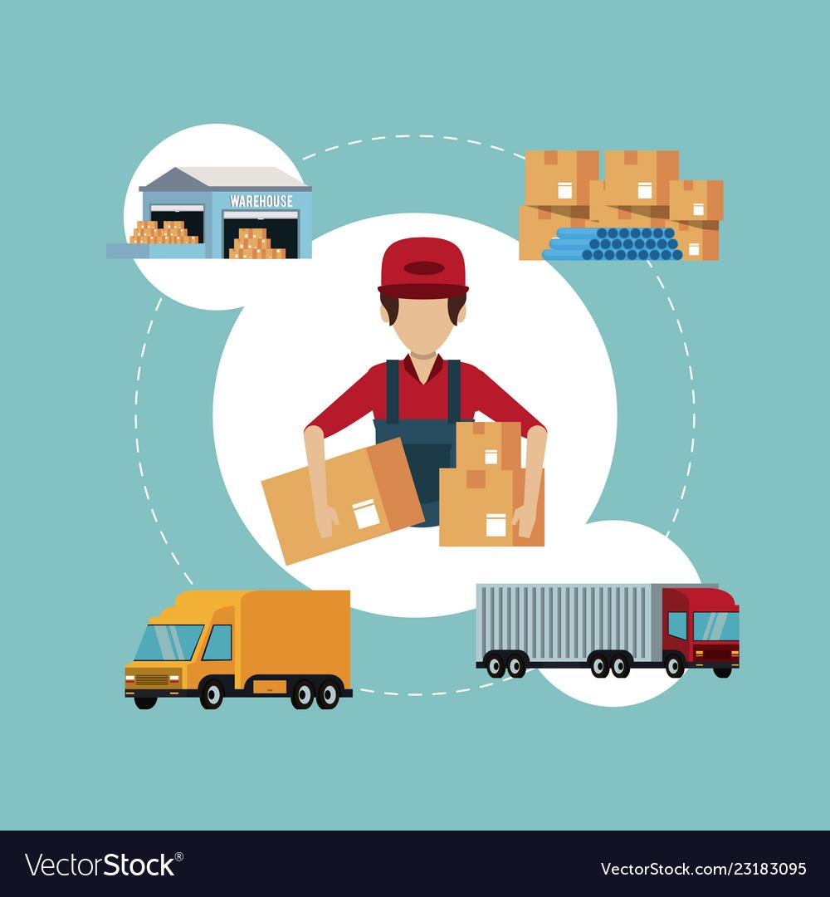
LOGISTIC & SUPPLY CHAIN ENGAGEMENT PLAN

Slide 28
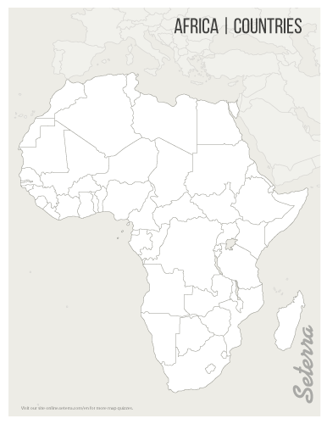
DC LOGISTIC HUBS IN AFRICA
AMU/UMA – Africa Maghreb Union
North Africa Region (4 states, 1 disputed territory
and one non fully member )
Suez Port, Egypt.
A
A
Cape Town, South Africa.
A
B
ECOWAS/CEDEAO – Economic of Western Africa
States Western Africa region (16 member states)
Accra Port, Ghana
SADC – Southern Africa Development Community Region
Southern Africa (16 member states)
Transnet Port Terminal, Cape Town, South Africa
C
C
B
Suez Canal, Egypt.
D
E
ECCAS/CEEAC – Economic Community of Central Africa States
Central Africa Region (11 member states)
Masaka Inland Depot, Kigali, Rwanda.
D
D
Kigali, Rwanda
E
EAC – East Africa Community
East Africa region (10 members states)
Kilindini Harbour, Mombasa, Kenya.
C
E
Mombasa, Kenya.
Assumptions:
1. Inter-connectivity with, air & land-water transportation to serve 5 different regions in Africa
2. Engaging with local companies in Africa to provide warehouse facilities (one facility hub and warehouse represent each region)
- To reduce administration works times with local authorities in Africa
Complex import & export regulations imply in each Africa
Comply with Trade and Industrial policy agreements with AU (Africa Union)
Notes:
AMU/UMA – Africa Maghreb Union Region (4 states, 1 disputed territory and one non fully member )
Suez Port, Egypt
Countries served: Egypt, Libya, Algeria, Tunisia, Morocco & West Sahara
ECOWAS/CEDEAO – Economic of Western Africa States (16 states)
Accra Port, Ghana
Countries served: Benin, Burkina Faso, Cape Verde, The Gambia, Ghana, Guinea, Guinea-Bissau, Ivory Coast, Liberia, Mali, Mauritania, Niger, Nigeria, Senegal, Sierra Leone, Togo
SADC – Southern Africa Development Community Region
Transnet Port Terminal, Cape Town, South Africa
Countries served: South Africa, Namibia, Bostwana, Eswatini, Lesotho, Zambia, Zimbabwe, Angola, Madagascar, Comoros Island, Mozambique, Malawi, Mauritius, Seychelles,
ECCAS/CEEAC – Central Africa Region (11 states)
Masaka Inland Depot, Kigali, Rwanda.
Countries served: Burundi, Cameroon, Central African Republic, Chad, Democratic Republic of the Congo, Republic of the Congo, Equatorial Guinea, Gabon, Rwanda, and São Tomé and Príncipe.
EAC – East Africa Community region (16 states)
Kilindini Harbour, Mombasa, Kenya.
Countries served: Kenya, Rwanda, Uganda, Tanzania, South Sudan, Sudan, Ethiopia, Somalia, Djibouti., Eritrea, Sudan

Slide 29
DC’S IMPLEMENTATION PLAN IN AFRICA
Facilities
Location: Hubs, FTZ, Infrastructure, Utilities
Layout: size, design, condition (temperature, contamination)
Total capacity
Equipments
Vehicles: Forklift, packaging machines, conveyor etc…
Machine: inbound, Packaging & warehousing, outbound
Safety Equipment, Insurances
Software, Hardware & Resources
WMS System (Software & Licenses)
Hardware: Computer, RFID devices, network, and communication
Resources Warehouse resources
Fully outsourced 3PL
Outsources to 4 3PL companies to serve 5 regions

Slide 30
SERVICES ENGAGEMENT OF 3PL
Onboarding
Initial onboarding
Establish contract agreement and legal works
Define engagement team,
Set up
One time setup activities,
Creating account and maintaining commercial information
Set up DC infrastructure, hardware and networking , software: WMS
Operational
services
Inbound Shipping & Receiving
Storage & warehousing
Outgoing shipping & Order fulfilling , reversed logistic, transportation
Maintenance and utilities
Account Management & Administration
Outsources 3PL at 5 regions in Africa

Slide 31
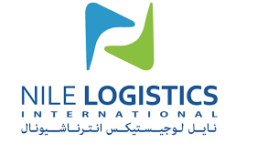
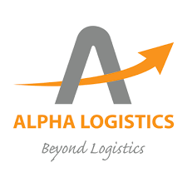


3PL COMPANY’S PORTFOLIO
Services Provide
The logistics solutions that 3PLs offer include receiving, storing, packing, and shipping services. Some 3PL companies also provide other logistics services, referred to as value added services. These include inventory management, kitting and assembly, postponement packaging, procurement and others.
Conglomerate company based in Africa that provide services in respective region in Africa
Nile Logistic International
Alpha Logistic
Based in Egypt
GLC listed company
Serves UMA
Based in Kenya
GLC listed company
Serves ECCAS/CEEAC Region
.
OMA Group
Infinity Group
Based in Egypt
GLC listed company
Serves ECOWAS/CEDEAO
Based in South Africa
GLC listed company
Serves SADC

Slide 32
OVERALL CONTRACT ENGAGEMENT VALUES
01
Alpha logistic. Kenya & Rwanda
02
OMA Group, Ghana
03
Nile International, Egypt
04
Infinite group S. Africa
Onboarding & Set up: EUR10200.00
Operational: 257620.00
Account Management, Sales and marketing : EUR: 310800.00
Value added + tax: EUR 36000
Special Discount 10%
TOTAL: EUR 518585.00
Onboarding & Set up: EUR 9180.00
Operational: 231858.00
Account Management, Sales and marketing : EUR: 279720.00
Value added + tax: EUR 32400
Special Discount 10%
TOTAL: EUR 466727.10
Onboarding & Set up: EUR11730.00
Operational: 296263.00
Account Management, Sales and marketing : EUR: 357420.00
Value added + tax: EUR 41400
Special Discount 10%
TOTAL EUR: 636131.70
Onboarding & Set up: EUR12750.00
Operational: 322025.00
Account Management, Sales and marketing : EUR: 388500.00
Value added + tax: EUR 45000
Special Discount 10%
TOTAL 691447.50
Assumption
1. overall of baseline cost of the contract engagement based on overall cost in East Africa
2. Overall cost at other regions is -10% in west Africa, +15% in North Africa and +25% in Southern Africa

Slide 33

ACCOUNT MANAGEMENT, SALE & MARKETING ENGAGEMENT PLAN

Slide 34
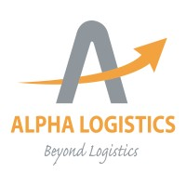

ACCOUNT MANAGEMENT, SALES & MARKETING ENGAGEMENT PLAN
Account Mgr 1
Account Mgr 2
Account Mgr 3
Account Magr 4
Managing sales, marketing and customer relationship with 3 PL and customers in UMA region
Managing sales, marketing and customer relationship with 3 PL and customers in EAC, ECCAS/CEEAC region
Managing sales, marketing and customer relationship with 3 PL and customers in ECOWAS/CEDEAO region
.
Managing sales, marketing and customer relationship with 3 PL and customers in SDAC region

Slide 35




LAW AND COMPLIANCE
Legal & Compliance
Ensure that a business, its employees and its projects comply with all relevant regulations and specifications
Ensure that the organization complies with all environmental, health and safety regulations.

Slide 36
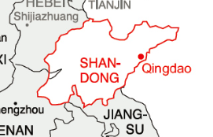

WAREHOUSE LOCATION
Regulation on market entity registration
Covers various business registration applications of market entities, establishment, modification, and cancellation. ^{[1]}
Exempt
Machinery and equipment imported for construction of productive infrastructure and capital construction material imported for construction of workshops and warehouses are exempt from tax. ^{[2]}
Reimbursed
Goods entering the zone from domestic suppliers is regarded as exported goods and can enjoy tax reimbursement for export. ^{[2]}

Slide 37


CONSTRUCTION CONTRACTS
A contract will be issued to well-known Chinese construction firms to develop the warehouse and the railway track.
China Wuyi Industrial Co., Ltd.
Railway line Construction
The Parties
Contractor
The Services
Payment
Due Date
Expenses
Liability Insurance
Expenses
Independent Contractor Status
Business licenses, Permits & Certificates
Sichuan Road & Bridge Co., LTD
Federal & State Taxes
Worker’s Compensation
Proprietary Information
Governing Law
Breach Waiver
Additional Terms & Conditions
Warehouse Construction Contract

Slide 38

LAW & REGULATIONS
Construction Law
Industrial Enterprises
This Law is enacted for the purpose of tightening supervision over and administration of construction activities, maintaining order of construction market, ensuring construction quality and safety, and promoting sound development of the construction
industry.^{[5]}
It ensures the consolidation and development of the economic sector under ownership by the people^{.[3]}
Property Law
Railway Law
Private real estate ownership is not permitted in China. China is a socialist nation where all land is either owned by the government.^{[4]}
Railways as referred to in this Law include State railways, local railways, industrial railways and railway private sidings.^{[6]}

Slide 39
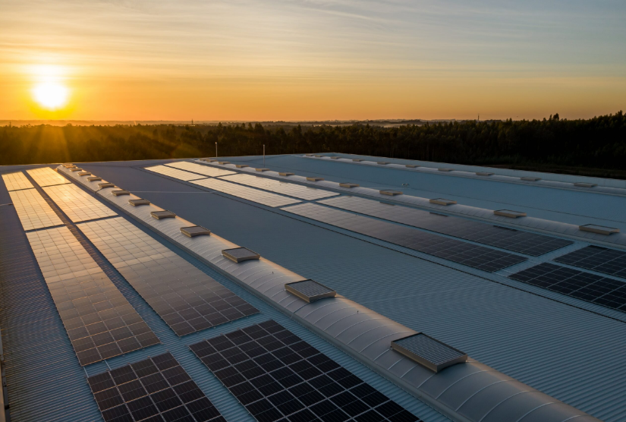




LAW ON EVALUATION OF ENVIRONMENTAL AND SAFETY FEASIBILITY
Investing in Electric Equipment
Installing more eco-friendly lighting
Deploy Rooftop Solar Panels
Initiate a Recycling Program
Rain water harvesting
This Law is enacted in order to implement the sustainable development strategy, to take precautions against adverse effects on the environment after implementation of plans and completion of construction projects, and to promote the coordinated development of the economy, society and environment.^{[7]}
Evaluation of Environmental Effects of Plans
Evaluation of Environmental Effects of Construction Projects

Slide 40
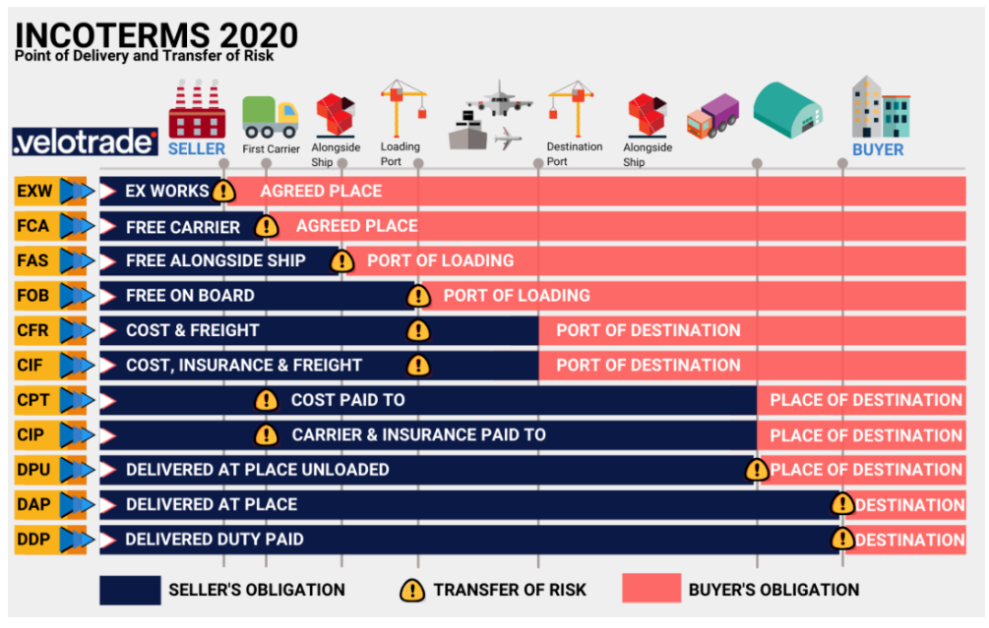
INCOTERMS
Incoterms is an acronym standing for international commercial terms. The Incoterms rules are standard sets of trading terms and conditions designed to assist traders when goods are sold and transported.^{[8]}
Cost, Insurance and Freight (CIF)
In international trade, as per CIF agreement seller will be responsible for all arrangements and transport costs for shipping goods to the agreed-upon destination port. Buyer then assumes all cost responsibilities once the ship has reached port. Additionally, the products being sent must be covered by a minimum level of maritime insurance from the seller.

Slide 41


FREIGHT FORWARDER
Golden Seed
COSCO Shipping Lines
Benefits
Benefits
A network of multiple logistics companies that helps reduce prices with more diversity.
Have a good understanding of logistics companies in many different specialty areas, including fragile goods, cold storage, etc.
They also handle all the paperwork associated with freight forwarding, including customs documentation, bills of landing, shipper’s export declarations, insurance forms, and letters of invoice.

Slide 42
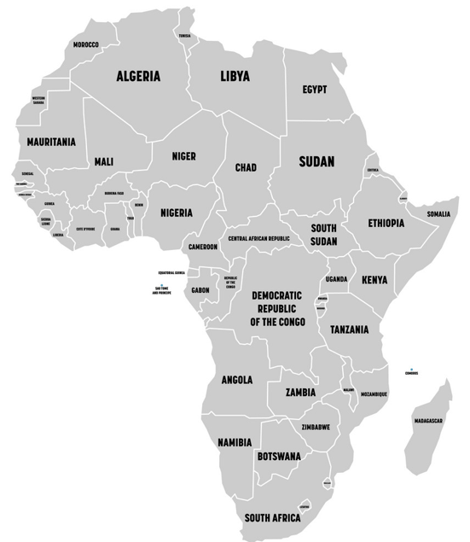
Egypt
IMPORT DUTIES & REGULATIONS
Kenya
Ghanaian customs practices and port infrastructure continue to present obstacles to trade. Officials have introduced risk-management approaches, such as the Pre-Arrival Assessment Reporting System.^{[9]}
The Customs Services Department under the Rwanda Revenue Authority has the primary function of collecting and accounting for import duties and taxes on imports. All importers must use clearing agents to process goods through customs.^{[10]}
The importer or the importer’s agent is required to present documents relating to the goods to the Customs Authority before the goods are shipped so that the goods can be marked with an initial customs registration number.^{[11]}
Ghana
The South African Revenue Service (SARS), a division of the Department of Finance/ Treasury, administers import duties and controls. The latter are implemented in consultation with the Department of Trade and Industry.^{[12]}
Rwanda
South Africa
The Customs Services Department (CSD) under the Kenya Revenue Authority (KRA) has the primary function of collecting and accounting for import duty and VAT on imports.^{[13]}

Slide 43
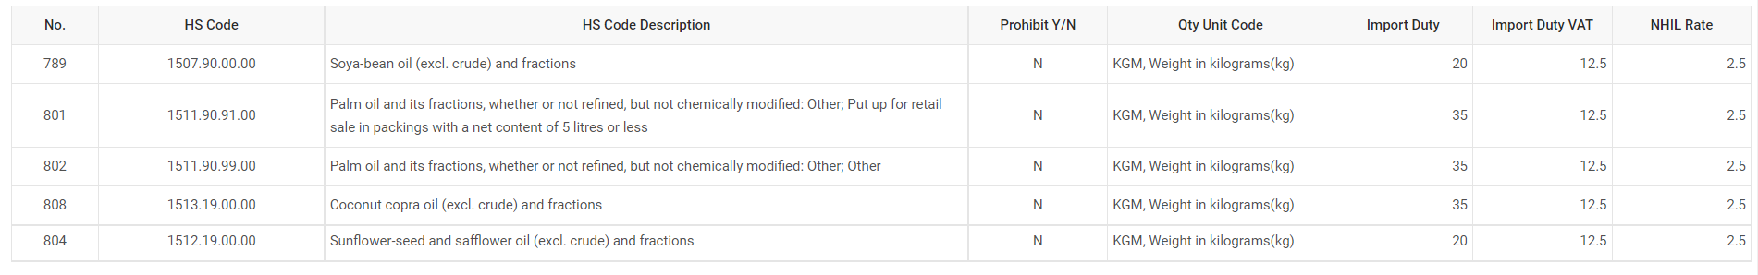
Ghana
Kenya
South Africa
Egypt
Rwanda
Soya Bean Oil – 20%
Palm Oil – 35%
Sunflower Oil – 20%
Soya Bean Oil – 35%
Palm Oil – 35%
Sunflower Oil – 35%
Soya Bean Oil – 10%
Palm Oil – 10%
Sunflower Oil – 10%
Soya Bean Oil – 20.5%
Palm Oil – 20.5%
Sunflower Oil – 20.5%
Soya Bean Oil – 25%
Palm Oil – 25%
Sunflower Oil – 25%

Slide 44
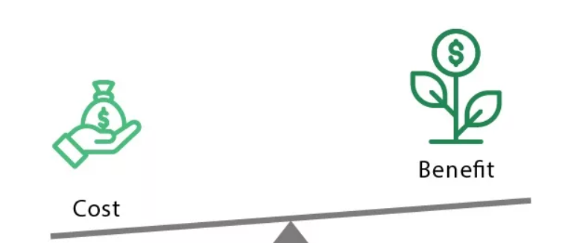
FINANCE ANALYSIS

Slide 45
Cost Benefit Analysis
Key Objectives:
1.Setting the Budget,Revenue and Profit Goal
2.Allocation of the Financial resources
3.Financial Feasibility study
4. Revenue Growth Analysis

Slide 46




THE FINANCIAL CYCLE OF A BUSINESS
Capital:
Money from Own Company
Loan
Capital
Fixed asset:
All elements required to start the sale
Products ,Machine,Labor,land etc
Profit
Fixed Asset
Sales
Sell the goods in the Market
Sales
Profit
Expecting profit by selling
Again Invest and pay loan from it

Slide 47
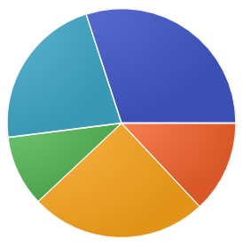
GOALS AND BUDGET DISTRIBUTION
Current Revenue in 2022
4.5Million€
Current Net Profit 60%
10%
Maintenance
20%
Building and Machinery maintenance, energy supply ,Insurance
Personnel
Overall Labour Cost
10%
New Warehouse investment Budget 5.4 Million euro
Marketing
50%
Logistics
Advertisement , Training program, Branding
Product(oil) Cost, Warehousing, storing, packaging and Transportation Cost
10%
Expected net Profit 63%
Finance
Expected Revenue 5.6Million€(25%)
Loan Payment with interest cost
* “ . “ used as decimal separator

Slide 48
Budget Breakdown for Setting The New Warehouse
2023 will be dedicated for whole process of construction and logistic setup
The next three years Investment has been calculated to analyse the progress.
For three consecutive years the budgets are 5.06 million euro,5.05 million euro and 5.35 million euro respectively
* “ . “ used as decimal separator

Slide 49
FINANCIAL FEASIBILITY STUDY
MAJOR INDICATORS
Return on Investment(ROI)
EBIT Margin
=((Gross profit - Operating expenses)/Net Revenue)*100%
= (Net Profit / Cost of Investment) x 100%
The higher the ROI percentage , the higher the profitability of the company
the higher it is, the smaller company's operating expenses in relation to total revenue
Net Profit %
Gross Profit %
= ((Net revenue- COGS)/Net Revenue)*100%
=((EBIT- Gross Profit)/Net Revenue)*100%
Helps to track company performance in terms of it's goods
The bottom line of a company's financial statement,which shows the actual profit after all expenses including tax,dept,operation cost.

Slide 50
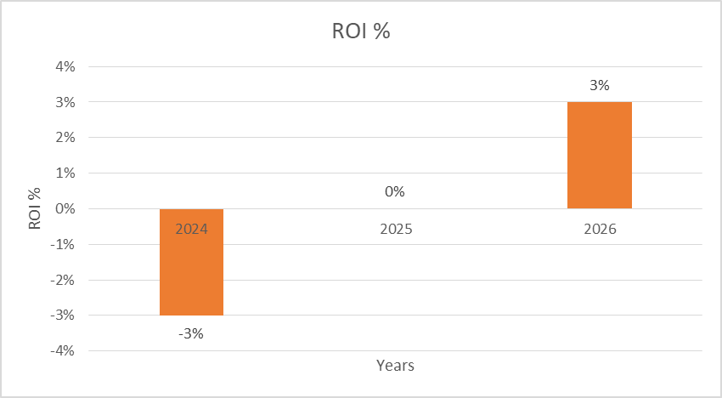
RETURN ON INVESTMENT
Return on investment or return on costs is the percentage of the ratio between net profit and investment.
Year
In 2024, ROI is Negative investment is generating a loss because of not being able to come up with the invested money
In 2025, ROI = 0% This is called Break-even point ,where we will neither get profit nor get loss,but all the cost is covered.
In 2026, ROI is Positive Revenue from investment earns profit
ROI in %

Slide 51
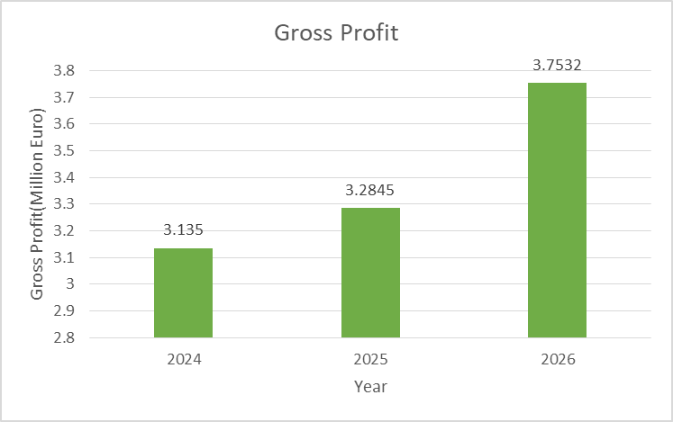
Gross Profit
GP % or Gross Margin is calculated by subtracting only the direct expenses or COGS from net Revenue, which depicts how much revenue is remaining to use for operating costs
Year
Gross margin
After covering the cost of goods sold, the remaining money is used to service other operating expenses like labor, maintenance , marketing expenses etc
The higher it is, the better it is for a company to pay off the business’s operating expenses
* “ . “ used as decimal separator

Slide 52
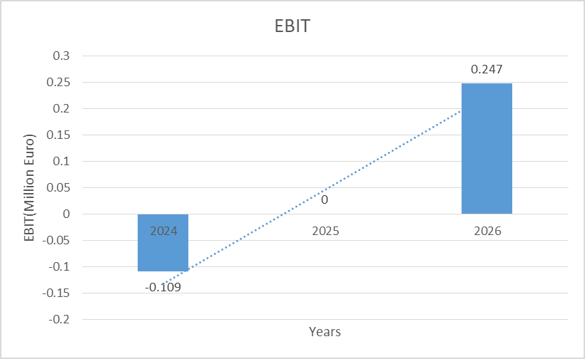
Earnings before interest and taxes
EBIT or Operating Margin % refers to the company's net income before income tax expense and interest expenses are deducted.
Year
It’s used to analyze a company's performance based on its operations so that investors can have an understanding how the company is performing
It doesn’t consider if a company has huge debt or no debt at all.
Operating margin
* “ . “ used as decimal separator

Slide 53
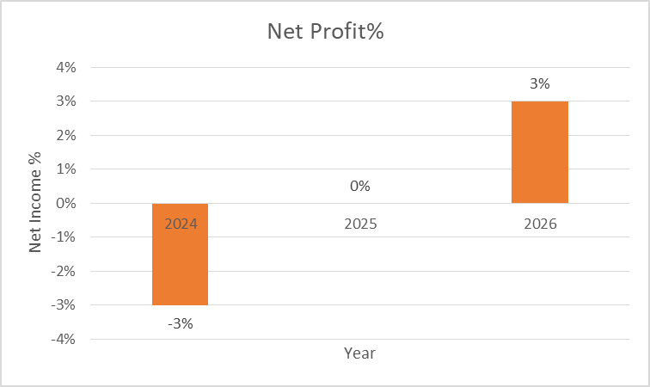

Net Profit
Net Profit refers to the ultimate profit of the company after deducting all operating, interest, and tax expenses
Year
Net profit
There will be a 3% loss in this project in 2024, though from 2025, it will level up the loss and expect for a 3% increased profit from 2026
In 2026, 0.16 Million Euro Profit can be gained by investing 5.4 Million Euro only for this new warehouse
Profit increment for this new investment is 3% by 3 years time

Slide 54
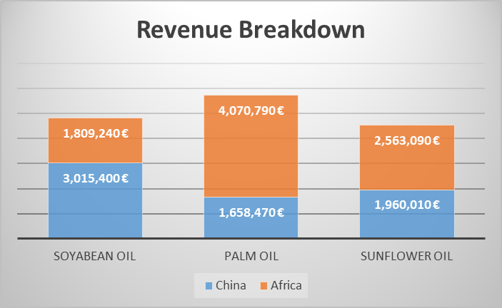
Revenue Breakdown Between Countries
The biggest revenue 4.07 Million Euro comes from palm oil Export and distribution in African market from China by three years
The 2nd largest revenue 3.02 Million Euro comes from Soyabean oil distribution in Chinese market by three years
* “ , “ used as thousand separator

Slide 55
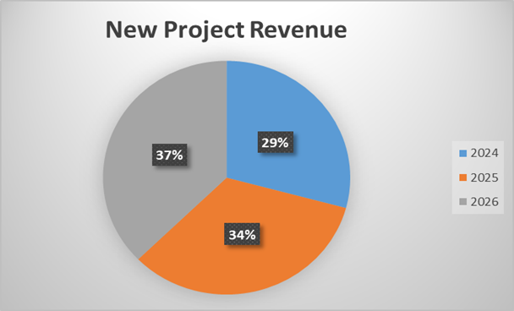
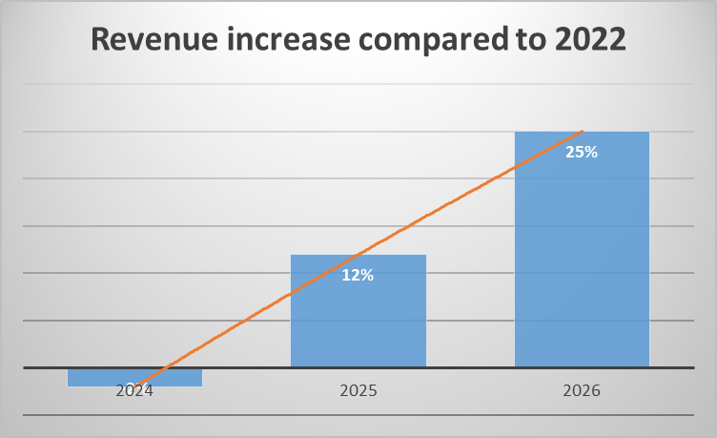
REVENUE GROWTH BY YEARS
€5.6 Million
Largest Revenue
Total Revenue € 4.5 Million
Total Revenue € 5.1
Million
2024
2026
2022
2025
Total Revenue €4.4Million
Total Revenue € 5.6
Million

Slide 56
Thank You

